Slide 1
Quick tech

Slide 2


Introduction
helps the blind people in its readers
help people to read large quantities of books in an organized and providing manner

Slide 3
Book
store

Slide 4
Valid questions
01. What Problem are we solving?
02. Why are we solving this problem ?
02. what is the problem scale?
04. Who are we designing for?

Slide 5
Valid questions
05. What age group are we designing for? Why?
06. what are their needs and goal? Why?
07. what are their desires when using the product?
08. what do we do differently that the market?

Slide 6
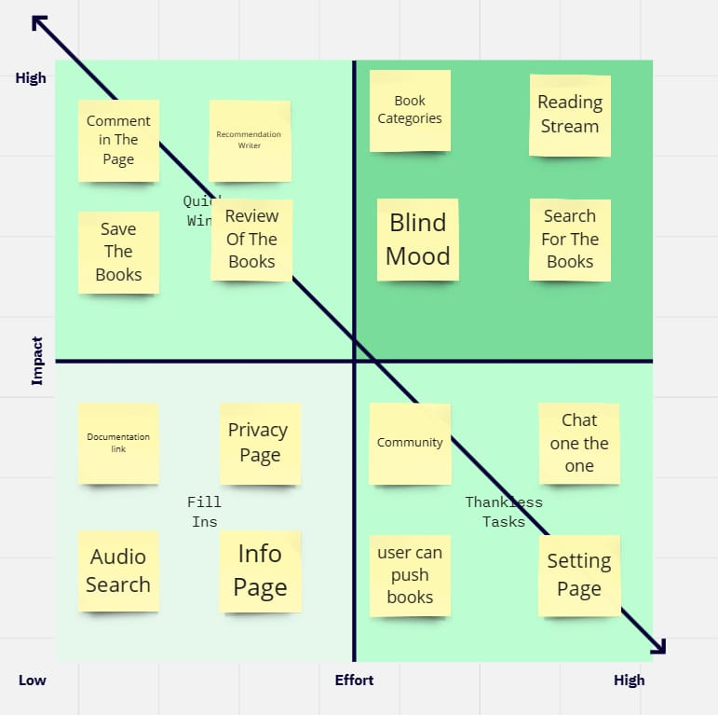
Priority matrix

Slide 7
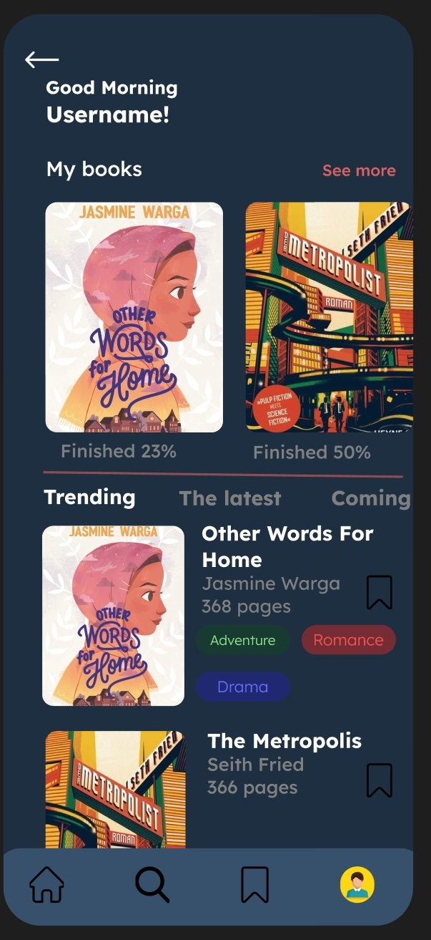
Home screen

Slide 8
Main function

Slide 9

Team members
Abdulrahman Ramadan
Hamdi Faraj
Youssef Hamza
Ziad Jalal
habiba sayed

Slide 10
Thanks !

